Slide 1

SOKOINE UNIVERSITY OF AGRICULTURE
School of Engineering and Technology | Department of Agricultural Engineering
AEN 214: INTRODUCTION TO ELECTRONICS — LECTURE 5
Bipolar Junction Transistor (BJT)
Physics, Biasing Rules, Operating Regions, DC Load Line, Saturated Switches & CE Amplifiers
Course Instructor: Dr. Kadeghe Goodluck Fue, PhD, P.Eng (T)
Electronics & Precision Agriculture Laboratory | Academic Year 2025/2026 | Sokoine University of Agriculture
Sokoine University of Agriculture | School of Engineering & Technology | Department of Agricultural Engineering
Slide 1 of 26

Slide 2
AEN 214: INTRODUCTION TO ELECTRONICS
Lecture 5 Learning Outcomes & Practical Scope
• Understand BJT Construction: Analyze physical doping, base width, NPN vs PNP topologies, and symbols.
• Master BJT Biasing Rules: Forward-biased emitter-base junction, reverse-biased collector-base junction, and voltages.
• Relate Transistor Currents: Derive I_E = I_B + I_C, current gains alpha and beta, and evaluate relationship beta = alpha / (1 - alpha).
• Analyze Circuit Configurations: Compare Common-Emitter (CE), Common-Base (CB), and Common-Collector (CC) modes.
• Plot Characteristic Curves & DC Load Line: Locate Cutoff, Active, and Saturation regions; determine Q-point.
• Prevent Thermal Runaway: Quantify leakage current I_CEO and design negative feedback emitter degeneration.
• Design Saturated Transistor Switches & CE Amplifiers: Interface microcontrollers to heavy farm relays, solenoids, and sensors.
Sokoine University of Agriculture | School of Engineering & Technology | Department of Agricultural Engineering
Slide 2 of 26

Slide 3
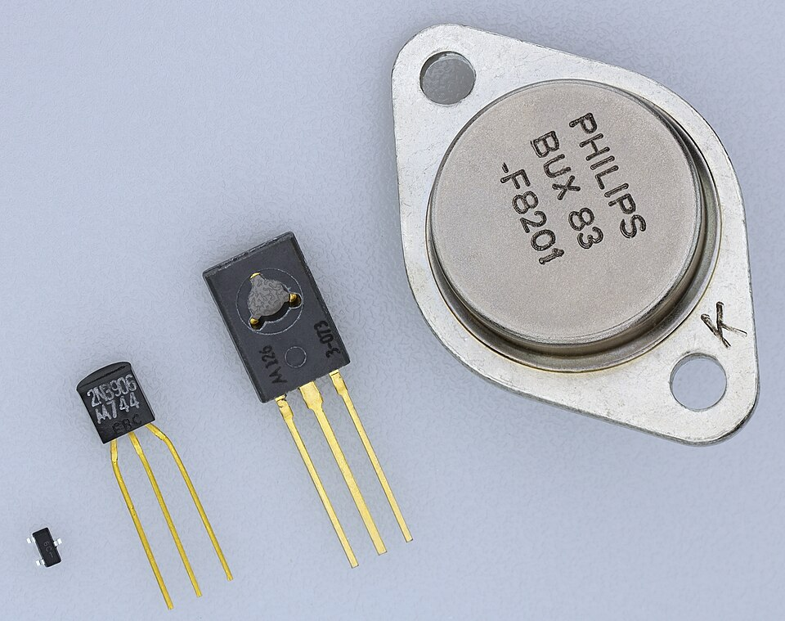
AEN 214: INTRODUCTION TO ELECTRONICS
The Transistor: The Engine of Agricultural Electronics
• The Solid-State Revolution: Replaced fragile mechanical contacts with robust solid-state amplification and switching.
• Microcontroller Actuator Driving: Arduino/ESP32 pins deliver only 20 mA; transistors switch 2A solenoids and 10A tractor fans.
• Sensor Signal Conditioning: Microvolt outputs from load cells and pH probes are amplified linearly by BJT stages before digitization.
• Harsh Agro-Climatic Thermal Stress: High ambient temperatures in engine bays and silos risk transistor thermal runaway.
• Reliable Machinery Automation: Understanding BJT saturation guarantees that irrigation valves open fully without burning out transistors.
Sokoine University of Agriculture | School of Engineering & Technology | Department of Agricultural Engineering
Slide 3 of 26

Slide 4

AEN 214: INTRODUCTION TO ELECTRONICS
BJT Physical Structure: Doping & Geometry
• Three-Terminal Architecture: Composed of three distinct semiconductor regions: Emitter (E), Base (B), and Collector (C).
• Emitter Region: Heavily doped (N⁺⁺ in NPN) to inject a massive quantity of majority charge carriers into the base.
• Base Region: Extremely thin (< 1 micrometer) and lightly doped (P⁻ in NPN) to minimize electron-hole recombination (< 1-2%).
• Collector Region: Moderately doped (N⁻) and physically large to dissipate heat generated by collecting carriers.
• Topologies: NPN Transistor (electrons are majority carriers; faster, most common); PNP Transistor (holes are majority carriers).
Sokoine University of Agriculture | School of Engineering & Technology | Department of Agricultural Engineering
Slide 4 of 26

Slide 5
AEN 214: INTRODUCTION TO ELECTRONICS
BJT Conduction Physics & Two Fundamental Biasing Rules
• Rule 1 (Base-Emitter Forward Bias): The base-emitter junction must be forward biased: V_BE ≈ 0.70 V for Silicon (0.3V for Ge).
• Rule 2 (Base-Collector Reverse Bias): The base-collector junction must be reverse biased: V_CB > 0 V (i.e. V_C > V_B in NPN).
• Carrier Injection Mechanism: Forward-biased BE junction injects massive flood of electrons from emitter into the ultra-thin base.
• Base Transit: Over 98-99% of injected electrons diffuse across the thin base without recombining, reaching the collector junction.
• Collector Sweeping: The intense reverse-bias electric field at the CB junction sweeps electrons into the collector, forming I_C.
Sokoine University of Agriculture | School of Engineering & Technology | Department of Agricultural Engineering
Slide 5 of 26

Slide 6
AEN 214: INTRODUCTION TO ELECTRONICS
Kirchhoff's Current Law & BJT Current Gains
• Current Conservation: By Kirchhoff's Current Law: I_E = I_B + I_C (Emitter current equals base plus collector current).
• Common-Base Current Gain (alpha): The fraction of emitter current reaching collector: alpha = I_C / I_E (typically 0.980 to 0.998).
• Common-Emitter Current Gain (beta or h_FE): Current amplification factor: beta = I_C / I_B (typically 50 to 400+).
• Inter-Gain Mathematical Relationship: Since I_E = I_B + I_C: beta = alpha / (1 - alpha); alpha = beta / (beta + 1).
• Base Current Magnitude: I_B = I_C / beta; Base current is minuscule compared to collector and emitter currents.
Sokoine University of Agriculture | School of Engineering & Technology | Department of Agricultural Engineering
Slide 6 of 26

Slide 7
AEN 214: INTRODUCTION TO ELECTRONICS
Comparative BJT Circuit Configurations
• Common-Emitter (CE): Input on Base, Output on Collector. High voltage gain (A_v > 100), high current gain (beta), 180° phase inversion.
• Common-Collector (CC / Emitter Follower): Input on Base, Output on Emitter. Unity voltage gain (A_v ≈ 1), high current gain.
• CC Impedance Transformation: High input impedance (Z_in > 100 kOhm) and low output impedance (Z_out < 50 Ohm); ideal sensor buffer.
• Common-Base (CB): Input on Emitter, Output on Collector. Current gain alpha < 1, high voltage gain, non-inverting; used in high-frequency RF.
• Agricultural Preference: CE is standard for digital switching and audio preamps; CC is standard for high-impedance transducer buffering.
Sokoine University of Agriculture | School of Engineering & Technology | Department of Agricultural Engineering
Slide 7 of 26

Slide 8
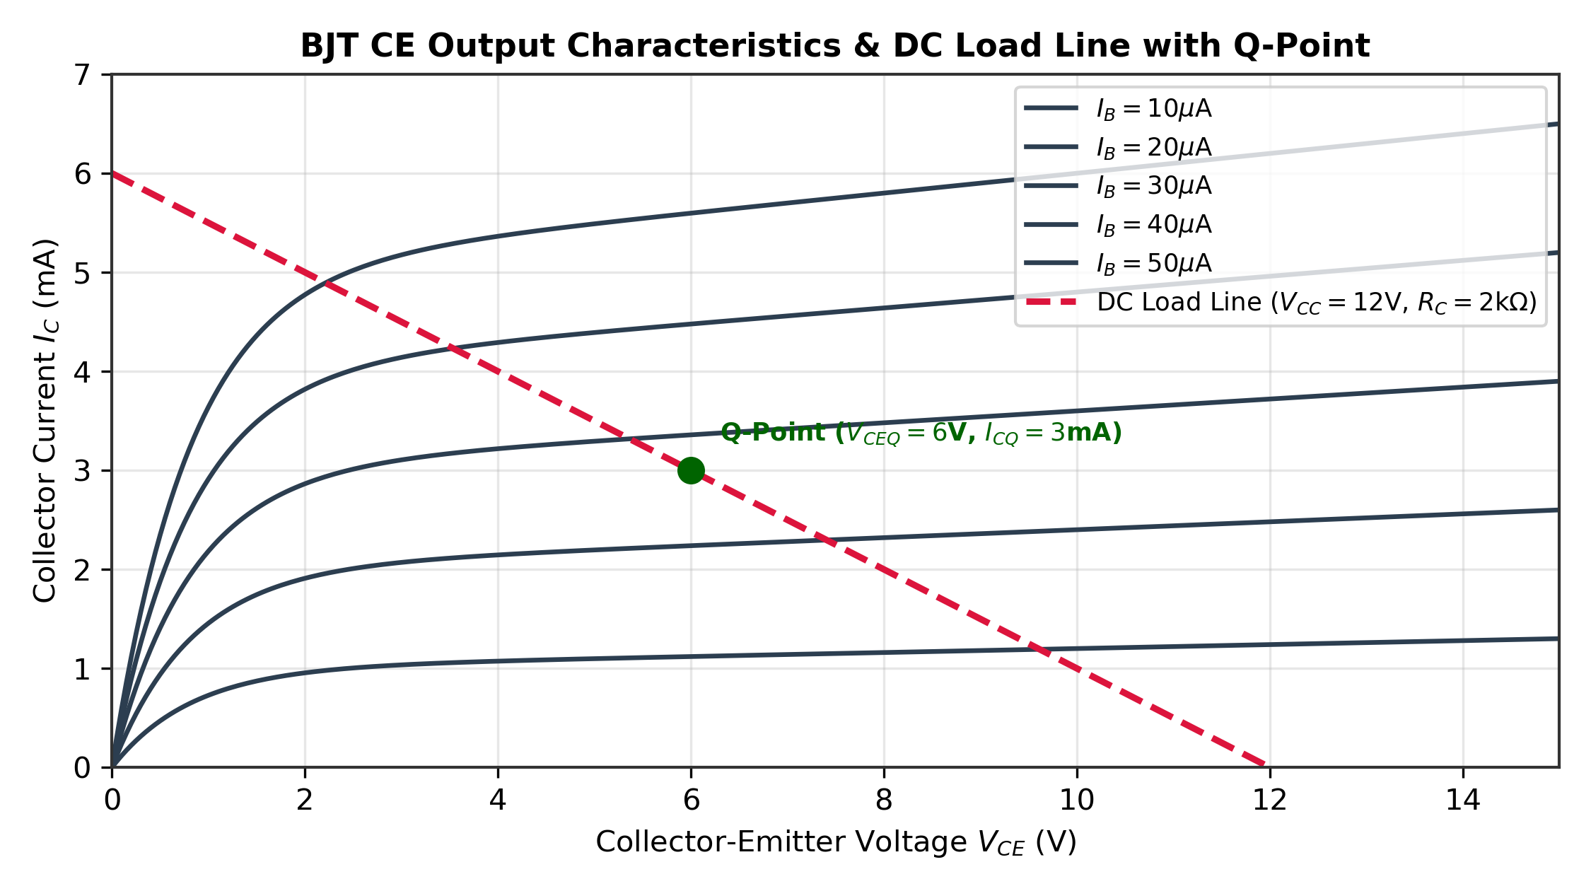
AEN 214: INTRODUCTION TO ELECTRONICS
BJT Common-Emitter Output Characteristics
• Output Characteristic Family: Plots Collector Current I_C versus Collector-Emitter Voltage V_CE for various constant Base Currents I_B.
• Cutoff Region: I_B = 0; both junctions reverse-biased; I_C ≈ I_CEO ≈ 0; transistor behaves as an open switch.
• Active (Linear) Region: BE forward-biased, CB reverse-biased; I_C = beta · I_B (nearly horizontal curves); used for linear amplification.
• Saturation Region: Both junctions forward-biased; V_CE drops to saturation voltage V_CE(sat) ≈ 0.1V to 0.2V; behaves as a closed switch.
• Breakdown Limit: Exceeding maximum collector-emitter rating V_CEO causes avalanche punch-through and transistor destruction.
Sokoine University of Agriculture | School of Engineering & Technology | Department of Agricultural Engineering
Slide 8 of 26

Slide 9
AEN 214: INTRODUCTION TO ELECTRONICS
DC Load Line Analysis & Optimal Q-Point
• Kirchhoff's Voltage Law in Output Loop: V_CC = I_C · R_C + V_CE -> I_C = (V_CC / R_C) - (V_CE / R_C).
• Load Line Endpoints: Point 1 (Saturation): V_CE = 0 -> I_C(sat) = V_CC / R_C; Point 2 (Cutoff): I_C = 0 -> V_CE(cutoff) = V_CC.
• Quiescent Operating Point (Q-point): The specific steady-state DC operating point (V_CEQ, I_CQ) at the intersection of load line and I_B curve.
• Optimal Linear Biasing: For maximum undistorted AC output swing in amplifiers, place Q-point at the center: V_CEQ = V_CC / 2.
• Digital Switching Biasing: Transistor switches between Cutoff (I_C = 0, V_CE = V_CC) and Full Saturation (V_CE = V_CE(sat), I_C = I_C(sat)).
Sokoine University of Agriculture | School of Engineering & Technology | Department of Agricultural Engineering
Slide 9 of 26

Slide 10
AEN 214: INTRODUCTION TO ELECTRONICS
Leakage Currents & Thermal Runaway Mitigation
• Reverse Collector-Base Leakage (I_CBO): Minority carrier leakage across reverse-biased CB junction with emitter open.
• Collector-Emitter Leakage (I_CEO): I_CEO = (beta + 1) · I_CBO; Base leakage is amplified by beta! Doubles every 10°C rise in temperature.
• The Thermal Runaway Feedback Loop: Temperature rise -> I_CBO surges -> I_C increases -> Power dissipation P_D = V_CE · I_C increases -> Heat increases -> Melts silicon!
• Emitter Degeneration Resistor (R_E): Placing resistor R_E in emitter leg provides negative feedback: If I_C rises -> V_E = I_E · R_E rises -> V_BE = V_B - V_E drops -> I_C drops!
• Stability Factor (S): S = dI_C / dI_CBO; Lower S provides superior bias stability against temperature fluctuations in tractor engine compartments.
Sokoine University of Agriculture | School of Engineering & Technology | Department of Agricultural Engineering
Slide 10 of 26

Slide 11
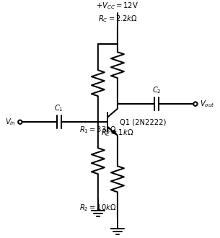
AEN 214: INTRODUCTION TO ELECTRONICS
Voltage Divider Bias: Universal Circuit Architecture
• Beta-Independent Biasing: Simple base resistor bias is heavily dependent on beta (which varies 300% across batches and temperature).
• Voltage Divider Topology: Resistors R_1 and R_2 form a stiff divider across supply V_CC, establishing fixed base voltage V_B.
• Thevenin Equivalent Analysis: V_TH = V_CC · [ R_2 / (R_1 + R_2) ]; R_TH = R_1 || R_2 = (R_1 · R_2) / (R_1 + R_2).
• Collector Current Equation: I_C ≈ I_E = (V_TH - V_BE) / [ R_E + (R_TH / (beta + 1)) ].
• Stiff Bias Design Condition: Design divider current to be at least 10 times base current: I_div >= 10 · I_B -> R_TH <= 0.10 · beta · R_E.
• Universal Stability: When condition holds: I_C ≈ (V_TH - 0.7 V) / R_E; completely independent of beta!
Sokoine University of Agriculture | School of Engineering & Technology | Department of Agricultural Engineering
Slide 11 of 26

Slide 12
AEN 214: INTRODUCTION TO ELECTRONICS
Worked Engineering Example 1: Universal Voltage Divider DC Bias Design
PROBLEM SPECIFICATION & AGRICULTURAL CONTEXT:
Design a stable voltage divider bias network for a 2N3904 NPN transistor in a Morogoro weather station anemometer pre-amplifier. Specifications: V_CC = 12.0 V, target quiescent collector current I_CQ = 2.0 mA, collector voltage V_CQ = 6.0 V, and beta = 150. Use standard design rules: set emitter voltage V_E = 0.10 · V_CC (1.2 V) and divider current I_div = 10 · I_B. Calculate: (a) Collector resistor R_C, (b) Emitter resistor R_E, (c) Bias resistors R_1 and R_2, (d) Exact Q-point (V_CEQ, I_CQ).
STEP-BY-STEP MATHEMATICAL SOLUTION & VERIFICATION:
1. Collector Resistor Calculation: Voltage drop across R_C: V_RC = V_CC - V_CQ = 12.0 V - 6.0 V = 6.0 V.
R_C = V_RC / I_CQ = 6.0 V / 2.0 mA = 3,000 Ohm (3.0 kOhm).
2. Emitter Resistor Calculation: With V_E = 1.20 V and I_E ≈ I_CQ = 2.0 mA: R_E = V_E / I_E = 1.20 V / 2.0 mA = 600 Ohm (use standard 620 Ohm).
3. Base Voltage & Base Current: V_B = V_E + V_BE = 1.20 V + 0.70 V = 1.90 V. Base current I_B = I_CQ / beta = 2.0 mA / 150 = 13.33 microA.
4. Sizing Voltage Divider Resistors: Divider current I_div = 10 · I_B = 10 · 13.33 microA = 133.3 microA.
R_2 = V_B / I_div = 1.90 V / 133.3 microA = 14,250 Ohm (use standard 15 kOhm).
R_1 = (V_CC - V_B) / (I_div + I_B) = (12.0 V - 1.90 V) / 146.6 microA = 10.1 V / 146.6 microA = 68,890 Ohm (use standard 68 kOhm).
5. Resulting Q-Point: V_CEQ = V_CQ - V_E = 6.0 V - 1.2 V = 4.80 V; I_CQ = 2.0 mA. (Robustly centered on load line!).
Sokoine University of Agriculture | School of Engineering & Technology | Department of Agricultural Engineering
Slide 12 of 26

Slide 13
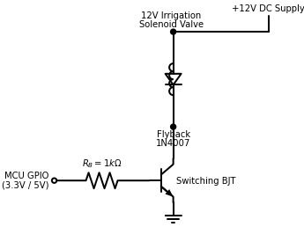
AEN 214: INTRODUCTION TO ELECTRONICS
BJT as a Saturated Low-Side Switch for Actuators
• Digital Switching Function: Operates between full OFF (Cutoff: I_B = 0, load de-energized) and full ON (Saturation: V_CE ≈ 0.2V, load energized).
• Low-Side Switching Architecture: Emitter connected to GND; load connected between V_CC and Collector; Base driven via series resistor R_B.
• Load Current in Saturation: I_C(sat) ≈ (V_CC - V_CE(sat)) / R_load ≈ V_CC / R_load.
• Overdrive Factor (ODF): To guarantee deep saturation against beta degradation and temperature, design base current with ODF = 2 to 5: I_B(sat) = ODF · [ I_C(sat) / beta_min ].
• Base Resistor Sizing Equation: R_B = (V_IN(logic) - V_BE(sat)) / I_B(sat).
• Transistor Conduction Loss: In saturation, power dissipated is minimal: P_sat = I_C(sat) · V_CE(sat) + I_B(sat) · V_BE(sat).
Sokoine University of Agriculture | School of Engineering & Technology | Department of Agricultural Engineering
Slide 13 of 26

Slide 14
AEN 214: INTRODUCTION TO ELECTRONICS
Driving Inductive Farm Actuators (Relays & Solenoids)
• Inductive Stored Energy: Relay coils and hydraulic valves store magnetic energy W = 0.5 · L · I².
• Turn-Off Inductive Spike: When base drive goes LOW, transistor cuts off instantaneously; coil forces v_L = -L(di/dt) -> hundreds of volts.
• Collector Punch-Through: Spike exceeds V_CEO rating of transistor; causes avalanche dielectric puncture and permanent short circuit.
• Flyback Diode Integration: Connect fast diode (1N4007 or UF4007) in parallel with coil, cathode to V_CC, anode to Collector.
• Safe Dissipation Loop: When BJT opens, inductive current circulates through forward-biased flyback diode, decaying harmlessly through coil internal resistance.
Sokoine University of Agriculture | School of Engineering & Technology | Department of Agricultural Engineering
Slide 14 of 26

Slide 15
AEN 214: INTRODUCTION TO ELECTRONICS
Worked Engineering Example 2: Automated Drip Irrigation Solenoid Driver Design
PROBLEM SPECIFICATION & AGRICULTURAL CONTEXT:
Design a low-side BJT saturated switch to drive a 12.0 V, 300 mA drip irrigation solenoid valve at Kilombero Sugar nursery. The circuit is controlled directly from an ESP32 microcontroller 3.3V digital GPIO pin (V_OH = 3.3 V, maximum pin current 12 mA). The transistor is a BD139 NPN power transistor with minimum beta_min = 40, V_BE(sat) = 0.85 V, and V_CE(sat) = 0.25 V. Use an overdrive factor ODF = 3. Determine: (a) Saturated collector current I_C(sat), (b) Required base current I_B(sat), (c) Base resistor R_B, (d) Transistor power dissipation in ON state, (e) Verify ESP32 pin current limit.
STEP-BY-STEP MATHEMATICAL SOLUTION & VERIFICATION:
1. Saturated Collector Current: I_C(sat) = (V_CC - V_CE(sat)) / R_solenoid = (12.0 V - 0.25 V) / (12.0 V / 0.30 A) = 11.75 V / 40.0 Ohm = 0.2938 A = 293.8 mA.
2. Calculate Required Base Current with ODF = 3: I_B(sat) = ODF · [ I_C(sat) / beta_min ] = 3 · [ 293.8 mA / 40 ] = 3 · 7.345 mA = 22.04 mA.
Check ESP32 Limit: 22 mA exceeds 12 mA pin limit! Adjust ODF to 1.5: I_B(sat) = 1.5 · 7.345 mA = 11.0 mA (safe for ESP32 pin!).
3. Base Resistor Calculation: R_B = (V_OH - V_BE(sat)) / I_B(sat) = (3.30 V - 0.85 V) / 11.0 mA = 2.45 V / 0.011 A = 222.7 Ohm (select standard 220 Ohm, 5%).
4. Transistor Power Dissipation in Saturated ON State:
P_sat = I_C(sat) · V_CE(sat) + I_B(sat) · V_BE(sat) = (0.294 A · 0.25 V) + (0.011 A · 0.85 V) = 0.0735 W + 0.0094 W = 0.0829 W = 82.9 mW.
5. Thermal Assessment: BD139 (TO-126 package rated at 1.25W free air) dissipates only 83 mW; operates completely cool without external heatsink.
Sokoine University of Agriculture | School of Engineering & Technology | Department of Agricultural Engineering
Slide 15 of 26

Slide 16
AEN 214: INTRODUCTION TO ELECTRONICS
Small-Signal BJT Models: re & Hybrid-pi Parameters
• Small-Signal Operation: When input AC signal amplitude is small (< 10 mV), non-linear exponential BJT curves are approximated linearly.
• AC Emitter Resistance (r_e): The dynamic resistance of the forward-biased base-emitter junction: r_e = V_T / I_EQ ≈ 26 mV / I_EQ.
• Hybrid-pi Input Resistance (r_pi): Dynamic input resistance looking into base: r_pi = (beta + 1) · r_e ≈ beta · r_e.
• Transconductance (g_m): Voltage-to-current gain factor: g_m = Delta I_C / Delta V_BE = I_CQ / V_T ≈ 38.5 · I_CQ (mA/V or mS).
• Small-Signal Collector Current: i_c = g_m · v_be = beta · i_b; Transistor acts as an ideal voltage-controlled current source.
Sokoine University of Agriculture | School of Engineering & Technology | Department of Agricultural Engineering
Slide 16 of 26

Slide 17
AEN 214: INTRODUCTION TO ELECTRONICS
Single-Stage Common-Emitter AC Amplifier
• Circuit Components: Coupling capacitors C_in and C_out block DC bias voltages while passing AC sensor signals freely.
• Emitter Bypass Capacitor (C_E): Placed in parallel with R_E; shorts AC signals to ground, boosting AC voltage gain.
• AC Small-Signal Equivalent Circuit: DC supplies replaced with AC ground; coupling and bypass capacitors replaced with AC short circuits.
• Voltage Gain with C_E: A_v = v_out / v_in = - (R_C || R_load) / r_e; Negative sign indicates 180° phase inversion.
• Voltage Gain without C_E (Unbypassed): A_v = - (R_C || R_load) / (r_e + R_E); Gain is reduced but linearized and stabilized against temperature.
• Input Impedance: Z_in = R_1 || R_2 || [ beta · (r_e + R_E) ]; Output Impedance: Z_out ≈ R_C.
Sokoine University of Agriculture | School of Engineering & Technology | Department of Agricultural Engineering
Slide 17 of 26

Slide 18
AEN 214: INTRODUCTION TO ELECTRONICS
Worked Engineering Example 3: CE Amplifier Gain for Grain Silo Acoustic Sensor
PROBLEM SPECIFICATION & AGRICULTURAL CONTEXT:
A single-stage Common-Emitter preamplifier boosts acoustic emission signals from a grain silo weevil sensor in Morogoro. Circuit parameters: V_CC = 15.0 V, R_1 = 47 kOhm, R_2 = 10 kOhm, R_C = 4.7 kOhm, R_E = 1.0 kOhm, load resistor R_load = 10 kOhm, beta = 200, and fully bypassed emitter (C_E = 100 microF). Quiescent current is established at I_CQ = 1.80 mA. Calculate: (a) Dynamic emitter resistance r_e, (b) AC load resistance r_L, (c) Small-signal voltage gain A_v, (d) Amplifier input impedance Z_in.
STEP-BY-STEP MATHEMATICAL SOLUTION & VERIFICATION:
1. Dynamic Emitter Resistance: r_e = 26 mV / I_EQ ≈ 26 mV / 1.80 mA = 14.44 Ohm.
2. Effective AC Collector Load: Collector sees R_C in parallel with R_load: r_L = R_C || R_load = (4.7 kOhm · 10 kOhm) / (4.7 + 10) = 47 / 14.7 = 3.197 kOhm = 3,197 Ohm.
3. Small-Signal Voltage Gain with Bypass Capacitor: A_v = - r_L / r_e = - 3,197 Ohm / 14.44 Ohm = - 221.4 (Inverting gain of 221.4x, or 46.9 dB).
4. Base Input Impedance: Dynamic base impedance Z_base = beta · r_e = 200 · 14.44 Ohm = 2,888 Ohm (2.89 kOhm).
5. Total Stage Input Impedance: Z_in = R_1 || R_2 || Z_base. Calculate parallel combination: R_1 || R_2 = (47 · 10) / 57 = 8.246 kOhm.
Z_in = (8.246 kOhm · 2.888 kOhm) / (8.246 + 2.888) = 23.81 / 11.13 = 2.139 kOhm (2.14 kOhm).
Sokoine University of Agriculture | School of Engineering & Technology | Department of Agricultural Engineering
Slide 18 of 26

Slide 19
AEN 214: INTRODUCTION TO ELECTRONICS
BJT Hardening for Agricultural Environments
• Thermal Sinking of Power BJTs: Packages like TO-220 (TIP122) and TO-247 must be torqued to aluminum heatsinks with mica isolators.
• Automotive Alternator Load Dump: Transistors on 12V tractor chassis must withstand 60V load dump transients during battery disconnection.
• Static Base Protection: High input impedance base circuits are susceptible to static charge; place 100 kOhm pulldown to ground.
• Conformal Coating: Salt mist and fertilizer ammonia cause dendritic copper growth between closely spaced TO-92 leads; silicone coat PCB.
• Base Overdrive Current Safety: Never connect a BJT base directly to a voltage supply without a series current-limiting resistor (destroys BE junction!).
Sokoine University of Agriculture | School of Engineering & Technology | Department of Agricultural Engineering
Slide 19 of 26

Slide 20
AEN 214: INTRODUCTION TO ELECTRONICS
Tanzanian Field Case Study 1: BJT Driver Thermal Runaway in Brooder Heaters
FIELD LOCATION & PROBLEM IDENTIFICATION
• Geographic Location: Poultry Brooder Facility, SUA Main Campus, Morogoro, Tanzania
An automated poultry chick brooder heating system used 2N3055 power BJTs to switch 12V electric heating mats. In the humid, 35°C brooder environment, the simple fixed base-resistor drive circuit suffered recurrent transistor burnouts every 2 weeks, leaving vulnerable day-old chicks without warmth and resulting in high chick mortality.
SUA ENGINEERING SOLUTION & AGRONOMIC IMPACT
SUA agricultural engineers diagnosed thermal runaway: As ambient temperature rose, BJT leakage I_CEO surged, increasing collector current and internal die temperature in a positive feedback loop until junction melting occurred. Engineers retrofitted the circuit with a negative feedback emitter degeneration resistor and a 1N4148 thermal compensation diode mounted directly on the heatsink.
Measurable Performance Metrics:
✔ Thermal runaway eliminated completely; zero transistor failures over 18 months.
✔ Brooder ambient temperature regulated to within ±0.4°C of target 34.0°C setpoint.
✔ Day-old chick survival rate increased from 82% to 98.5%.
Sokoine University of Agriculture | School of Engineering & Technology | Department of Agricultural Engineering
Slide 20 of 26

Slide 21
AEN 214: INTRODUCTION TO ELECTRONICS
Tanzanian Field Case Study 2: Tractor Hydraulic Solenoid Valve Driver Upgrade
FIELD LOCATION & PROBLEM IDENTIFICATION
• Geographic Location: Kilombero Sugar Estate Sugarcane Mechanization Depot, Tanzania
Sugarcane haulage tractors retrofitted with automated GPS row-following steering used discrete BJT low-side switches to actuate electro-hydraulic steering spool valves. Drivers frequently burnt out during hot midday operations because base drive resistors were undersized, keeping transistors in the active region rather than deep saturation.
SUA ENGINEERING SOLUTION & AGRONOMIC IMPACT
Engineers discovered that the BD139 transistors were operating with V_CE = 1.4V instead of V_CE(sat) = 0.2V, causing them to dissipate P = 1.4V · 1.5A = 2.1W continuously in free air. By redesigning the base drive circuit with an overdrive factor ODF = 3 and adding a complementary buffer stage, V_CE collapsed to 0.18V, dropping dissipation to 0.27W.
Measurable Performance Metrics:
✔ Transistor operating temperature plummeted from 135°C to a cool 48°C.
✔ Steering hydraulic response time improved from 280 ms to 45 ms.
✔ Enabled continuous 24-hour sugarcane harvesting operations without electrical shutdowns.
Sokoine University of Agriculture | School of Engineering & Technology | Department of Agricultural Engineering
Slide 21 of 26

Slide 22
AEN 214: INTRODUCTION TO ELECTRONICS
Laboratory Bench Protocol: BJT Static Characteristics & Saturated Switch Verification
PRACTICAL LAB LEARNING OUTCOMES & BENCH REQUIREMENTS:
• Measure BJT common-emitter output characteristics and plot family of curves on DSO/curve tracer.
• Determine current gain beta (h_FE) and observe beta variation with collector current.
• Assemble a saturated low-side BJT relay driver circuit and measure V_CE(sat) and V_BE(sat).
• Wire a single-stage Common-Emitter amplifier and measure voltage gain with and without bypass capacitor.
STEP-BY-STEP PROTOTYPING & DIAGNOSTIC PROCEDURE:
Step 1: Mount 2N3904 NPN transistor on breadboard. Wire 100 kOhm potentiometer in base circuit and 1 kOhm resistor in collector.
Step 2: Set I_B to 10 microA, 20 microA, 30 microA; sweep V_CC from 0 to 12V; record I_C and V_CE; plot CE characteristics.
Step 3: Measure V_CE(sat) while driving 12V relay coil with I_B = 1.0 mA; confirm V_CE(sat) <= 0.2V.
Step 4: Wire voltage divider CE amplifier (R_1=47k, R_2=10k, R_C=3.3k, R_E=680, C_E=47uF). Inject 1 kHz, 10 mV sine wave.
Step 5: Measure output amplitude on DSO; verify 180° phase inversion and compute voltage gain A_v; remove C_E and observe gain reduction.
Sokoine University of Agriculture | School of Engineering & Technology | Department of Agricultural Engineering
Slide 22 of 26

Slide 23
AEN 214: INTRODUCTION TO ELECTRONICS
Diagnostic Troubleshooting of BJT Circuits
• Floating Base Terminal: Leaving base unconnected allows electrostatic noise to turn transistor partially ON; always use pulldown resistor.
• Active Region Overheating: Inadequate base current keeps switching transistor in active region (high V_CE · I_C); transistor scorches PCB.
• Reversed Collector and Emitter: Transistor will still amplify slightly (inverse beta ≈ 2-5), but voltage rating collapses and gain is terrible.
• Open-Circuit Base-Emitter Junction: DMM diode check reads 'OL' from Base to Emitter; caused by excessive reverse base-emitter voltage (> 6V).
• Collector-Emitter Short Circuit: DMM reads 0 Ohm between Collector and Emitter in both directions; caused by overvoltage or thermal melting.
Sokoine University of Agriculture | School of Engineering & Technology | Department of Agricultural Engineering
Slide 23 of 26

Slide 24
AEN 214: INTRODUCTION TO ELECTRONICS
Lecture 5 Self-Assessment & Upcoming Topics
SELF-ASSESSMENT & PROBLEM-SOLVING EXERCISES:
Q: State the two fundamental biasing rules for a BJT operating in the active linear region.
Q: Derive the relationship between common-base current gain alpha and common-emitter current gain beta.
Q: Explain the mechanism of thermal runaway in a BJT. How does an emitter degeneration resistor provide negative feedback stabilization?
Q: Why is an overdrive factor (ODF) necessary when designing a BJT saturated switch to drive an inductive farm solenoid valve?
Q: Explain the function of coupling capacitors C_in, C_out and emitter bypass capacitor C_E in a single-stage CE amplifier.
NEXT LECTURE PREVIEW & REQUIRED PREPARATION:
Lecture 6 will explore Field Effect Transistors (FETs): JFETs, MOSFETs, gate charge dynamics, and power MOSFETs in solar pump drivers.
Sokoine University of Agriculture | School of Engineering & Technology | Department of Agricultural Engineering
Slide 24 of 26

Slide 25
AEN 214: INTRODUCTION TO ELECTRONICS
Lecture 5 Synthesis: Key Takeaways & Formula Sheet
CORE CONCEPTUAL TAKEAWAYS
✔ The BJT is a current-controlled bipolar device: A small base current I_B controls a large collector current I_C = beta · I_B.
✔ Operating regions: Cutoff (switch OFF), Saturation (switch ON, V_CE ≈ 0.2V), and Active (linear amplifier).
✔ Voltage divider bias provides stable, beta-independent quiescent Q-point operation against temperature swings.
✔ Saturated switches require base overdrive (ODF >= 2) to ensure minimum saturation voltage and low conduction losses.
✔ Inductive loads require mandatory flyback diode clamping across relay coils to prevent transistor collector punch-through.
CRITICAL ENGINEERING FORMULAS
★ Current Conservation: I_E = I_B + I_C
★ Current Gains: alpha = I_C / I_E; beta = I_C / I_B = alpha / (1 - alpha)
★ DC Load Line: I_C = (V_CC / R_C) - (V_CE / R_C)
★ Saturated Switch Base Current: I_B(sat) = ODF · [ I_C(sat) / beta_min ]
★ Dynamic Emitter Resistance: r_e ≈ 26 mV / I_EQ
★ CE Voltage Gain: A_v = - (R_C || R_load) / r_e (bypassed)
★ Input Impedance: Z_in = R_1 || R_2 || (beta · r_e)
Sokoine University of Agriculture | School of Engineering & Technology | Department of Agricultural Engineering
Slide 25 of 26

Slide 26
AEN 214: INTRODUCTION TO ELECTRONICS
Prescribed References & Practical Laboratory Preparation
• Boylestad, R. L., & Nashelsky, L. (2018). Electronic Devices and Circuit Theory (11th ed.). Pearson Education.
• Sedra, A. S., & Smith, K. C. (2020). Microelectronic Circuits (8th ed.). Oxford University Press.
• Floyd, T. L. (2017). Electronic Devices: Conventional Current Version (10th ed.). Pearson.
• Laboratory Preparation: Review BJT pinout configurations (TO-92 EBC vs CBE) before attending Lab Session 5.
• Field Assignment: Complete Assignment 2, Questions 5 to 8 on BJT biasing and saturated switching.
Sokoine University of Agriculture | School of Engineering & Technology | Department of Agricultural Engineering
Slide 26 of 26

